Slide 1

Slide with example image in a Placeholder box
Another text box to add complexity

Slide 2
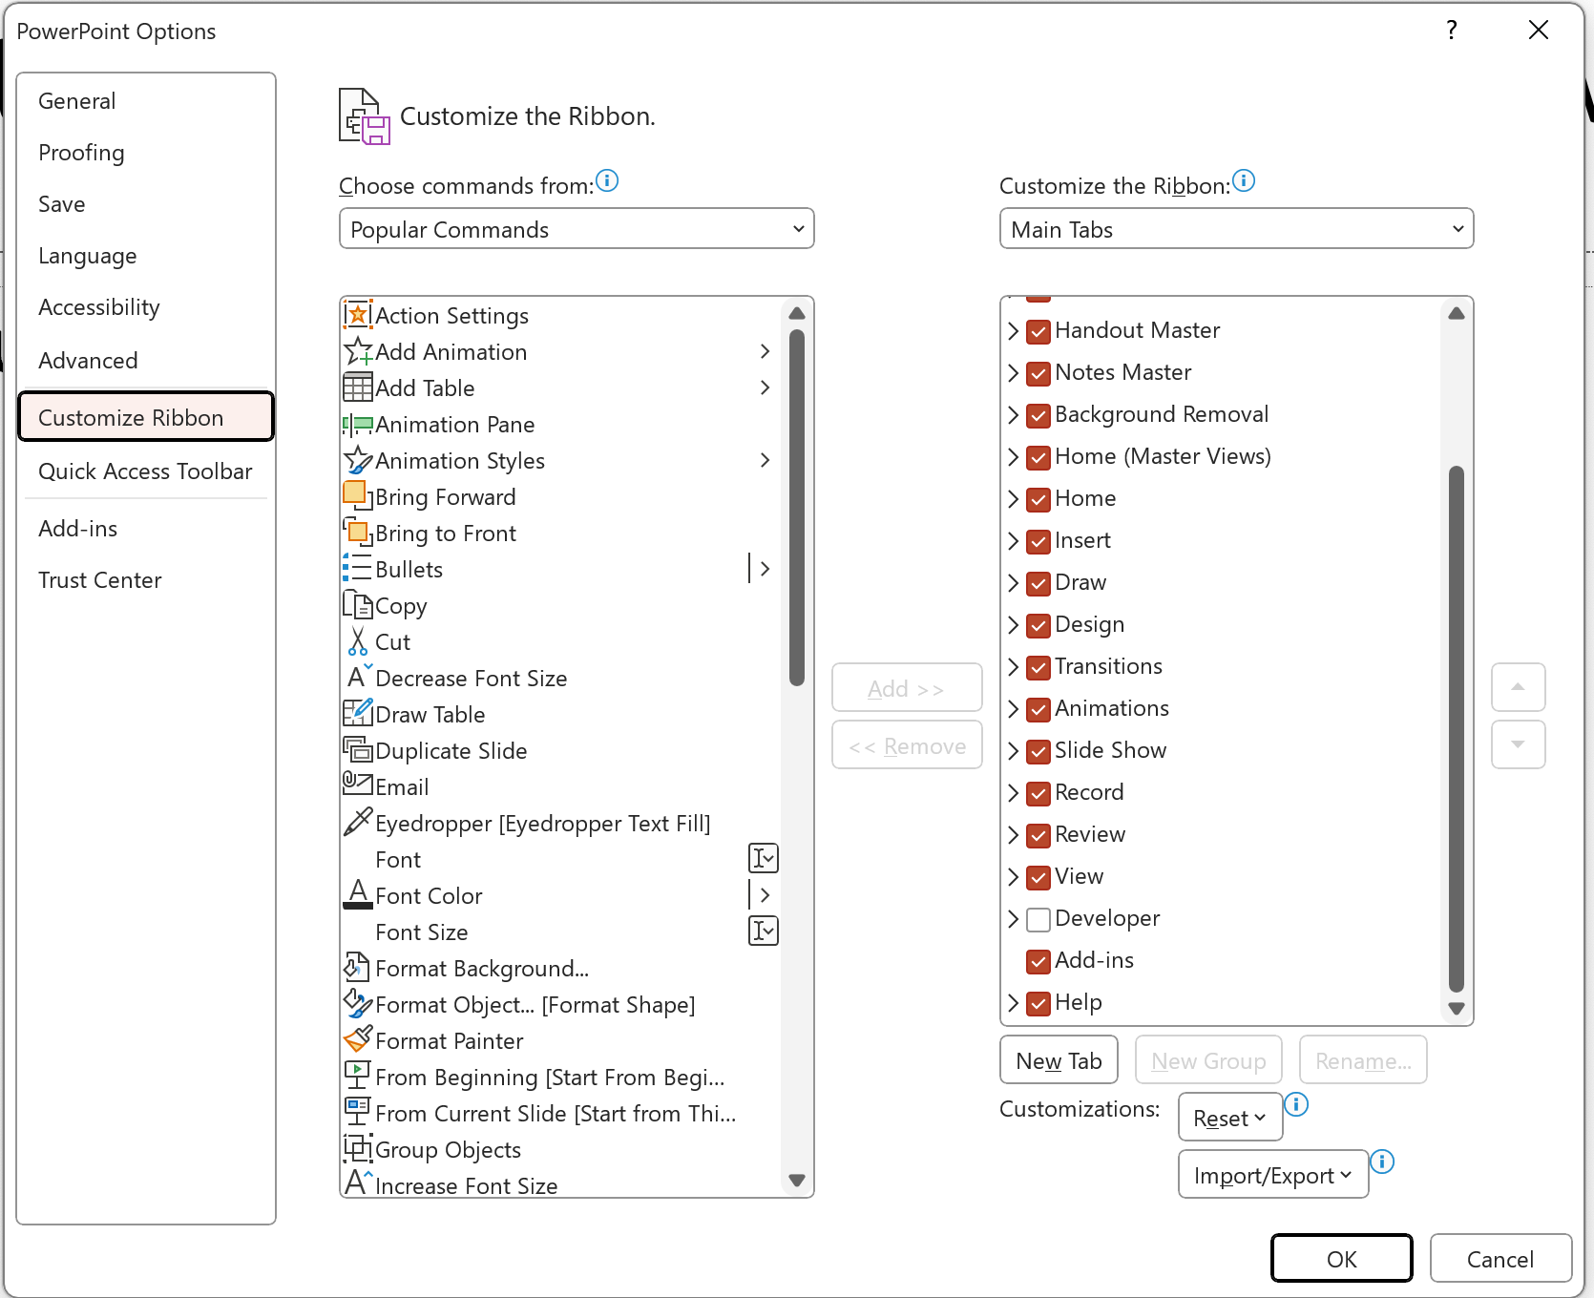
Getting Started with VBA in Powerpoint
Under options / Customize Ribbon, Add the Developer ribbon menu to get access to tools like the macro Record feature and easy display VBA editor

Slide 3
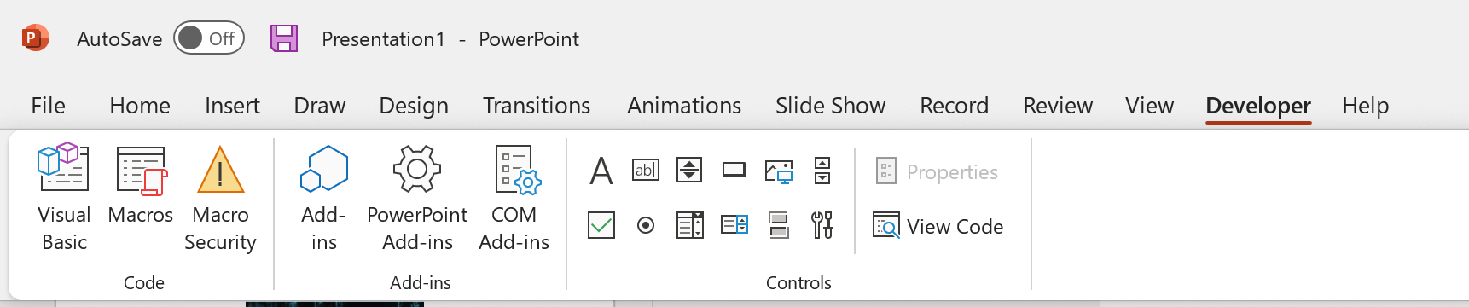
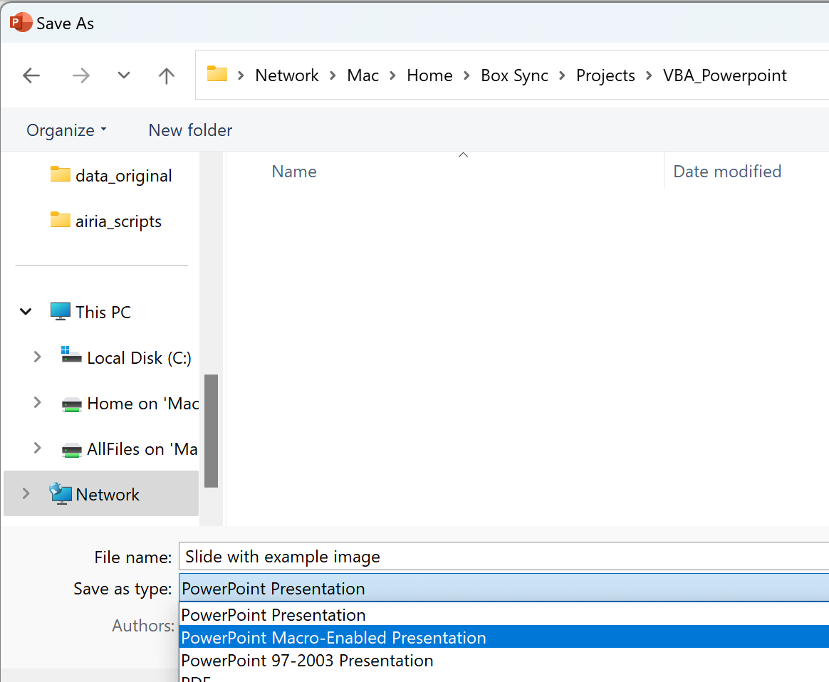
Getting Started (Continued)
Click Visual Basic to open the VBA Editor
Click Macros to run a macro
Macro-containing files need to be saved as Macro-Enabled Presentation (e.g. *.pptm file extension)

